Slide 1
DBMS MINI PROJECT Online Shop for shoes
Team Name: Project Sandal Group Members
S No. | Name | Roll No.
1 | Jayannthan P T | 205001049
2 | Kishaanth S | 205001054
3 | Koushik Viswanath S | 205001055

Slide 2
Entity Relational Model

Slide 3
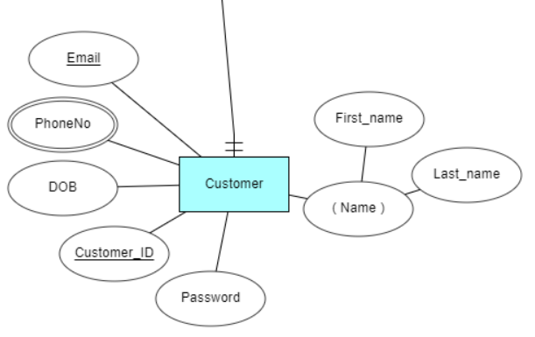
Entity Relational Model
Customer Entity

Slide 4
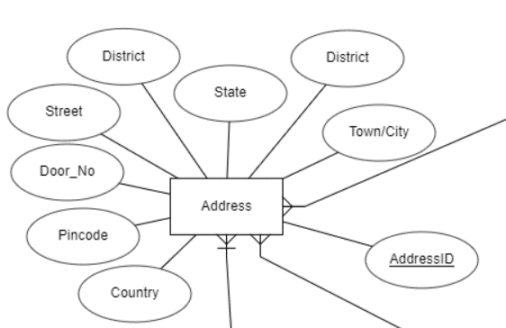
Entity Relational Model
Address Entity

Slide 5
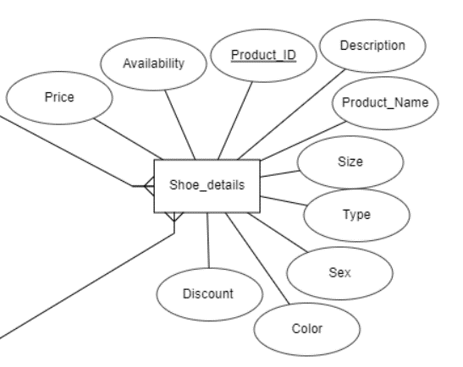
Entity Relational Model
Shoe Details Entity

Slide 6
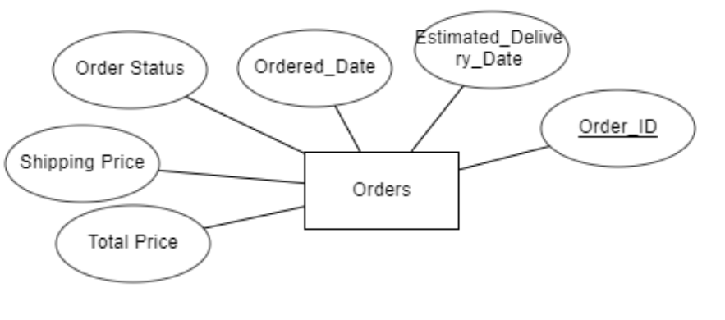
Entity Relational Model
Order Entity

Slide 7
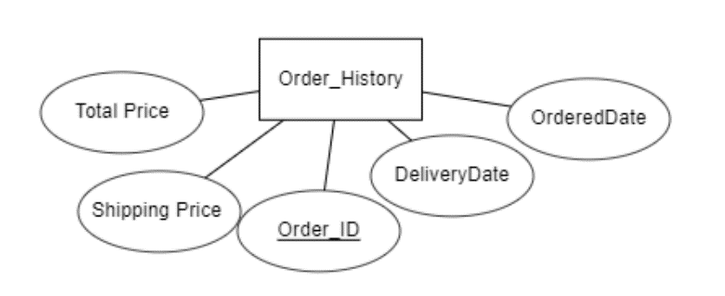
Entity Relational Model
Order History Entity

Slide 8
Entity Relational Model With Relations

Slide 9
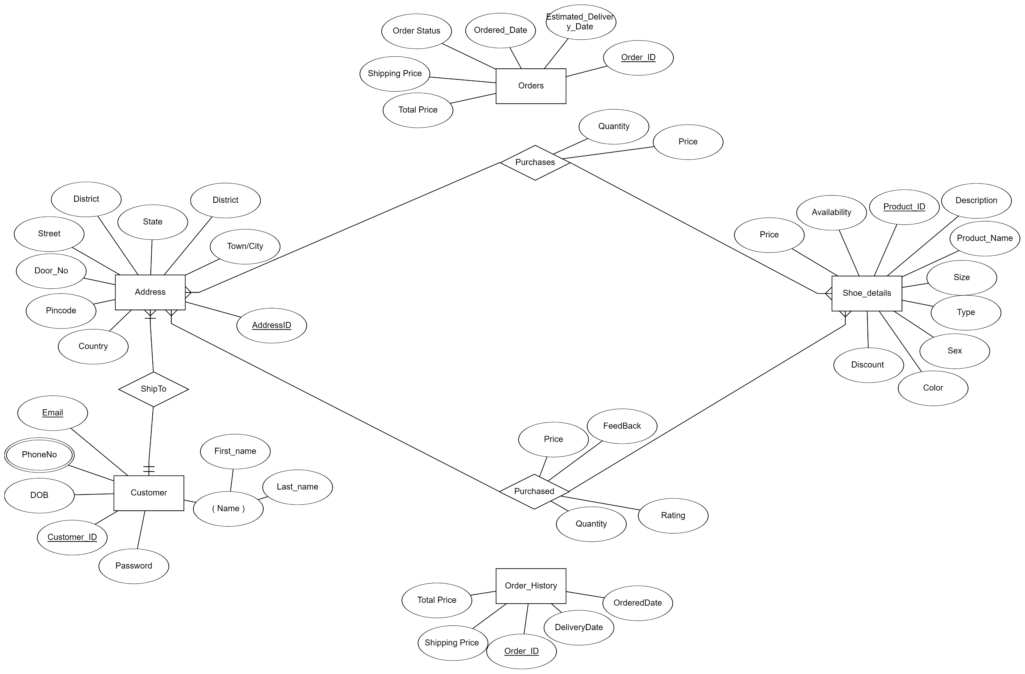

Slide 10
Entity Relational Model TO Relational Schema

Slide 11
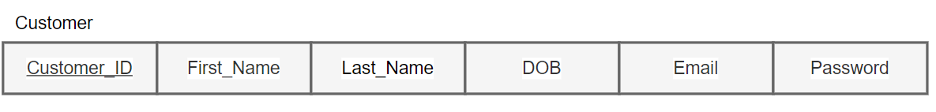
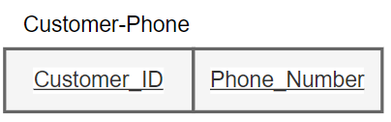
Entity Relational Model TO Relational Schema
Customer Relation

Slide 12
Entity Relational Model TO Relational Schema
Customer Relation
Primary Key: Customer_ID
Functional Dependencies:
Customer_ID -> First_Name, Last_Name, DOB, Email, Password
Primary Key: Customer_ID, Phone_Number

Slide 13
Entity Relational Model TO Relational Schema
Address Relation

Slide 14
Entity Relational Model TO Relational Schema
Address Relation
Primary Key: AddressID, Customer_ID
Functional Dependencies:
AddressID -> Door_No,Street,Town/City,District,State,Country,Pincode

Slide 15
Entity Relational Model TO Relational Schema
Shoe Details Relation

Slide 16
Entity Relational Model TO Relational Schema
Shoe Details Relation
Primary Key: Product_ID
Functional Dependencies:
Product_ID -> Product_Name, Description, Size, Type, Sex, Color, Availability, Price, Discount
Product_ Name -> Type, Sex

Slide 17
Entity Relational Model TO Relational Schema
Orders Relation

Slide 18
Entity Relational Model TO Relational Schema
Orders Relation
Primary Key: Order_ID, Product_ID
Functional Dependencies:
Order_ID -> Address_ID, Ordered_Date, Estimated_Delivery_Date, Total_Price, Shipping_Price, Order_Status
Order_ID, Product_ID -> Quantity, Price

Slide 19
Entity Relational Model TO Relational Schema
Order_History Relation

Slide 20
Entity Relational Model TO Relational Schema
Order_History Relation
Primary Key: Order_ID, Product_ID
Functional Dependencies:
Order_ID, Product_ID -> Quantity, Price, Feedback, Rating
Order_ID -> Address_ID, Ordered_Date, Delivery_Date, Total_Price, Shipping_Price

Slide 21
Entity Relational Model TO Relational Schema

Slide 22
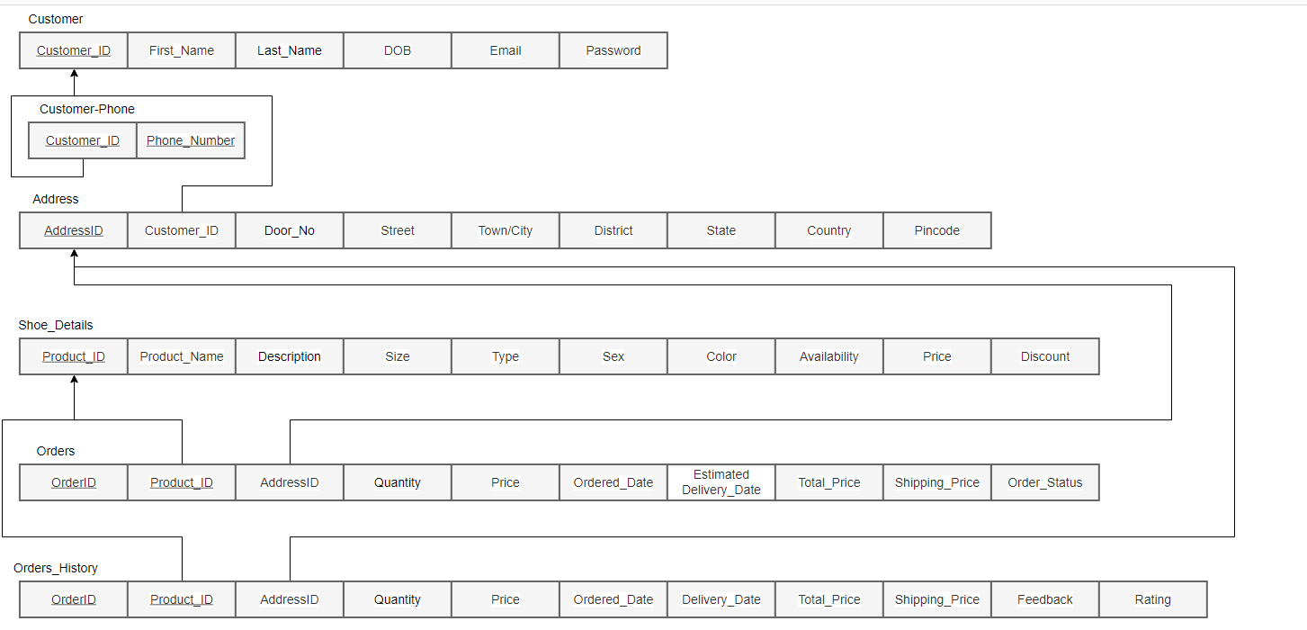
Entity Relational Model TO Relational Schema

Slide 23
Relational Schema

Slide 24
Relational Schema – Normalization

Slide 25
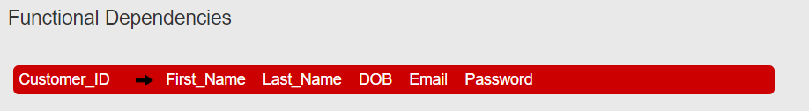
Relational Schema -Normalization
Customer Relation
First, find the minimal cover of the FDs, which includes the FDs Customer_ID --> First_Name Customer_ID --> Last_Name Customer_ID --> DOB Customer_ID --> Email Customer_ID --> Password
The table is in 2NF already
Table already in 3NF

Slide 26
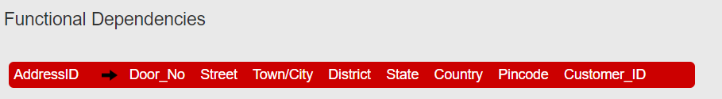
Relational Schema -Normalization
Address Relation
First, find the minimal cover of the FDs, which includes the FDs AddressID --> Door_No AddressID --> Street AddressID --> Town/City AddressID --> District AddressID --> State AddressID --> Country AddressID --> Pincode AddressID --> Customer_ID
The table is in 2NF already
Table already in 3NF

Slide 27
Relational Schema -Normalization
Shoe Details Relation
First, find the minimal cover of the FDs, which includes the FDs Product_ID --> Product_Name Product_ID --> Description Product_ID --> Sex Product_ID --> Color Product_ID --> Availability Product_ID --> Price Product_ID --> Discount Product_Name --> Type Product_Name --> Size
The table is in 2NF already

Slide 28
Relational Schema -Normalization
Shoe Details Relation
Initially Shoe_Details is the original table with the original functional dependencies. In each round we check the FDs one by one to see if there is a violation of 3NF (there is a partial or transitive dependency where the RHS includes non-key attributes). If yes, we decompose the table into two.
Round1: checking table Shoe_Details The table is not in 3NF. Product_Details = (Product_Name,Type,Size), with FDs: Product_Name --> Type,Size Shoe_Details = (Product_ID,Product_Name,Description,Sex,Color,Availability,Price,Discount), with FDs: Product_ID --> Product_Name,Description,Sex,Color,Availability,Price,Discount Round2: checking table Product_Details ***** The table is in 3NF already, send it to output *****
Round3: checking table Shoe_Details ***** The table is in 3NF already, send it to output *****

Slide 29
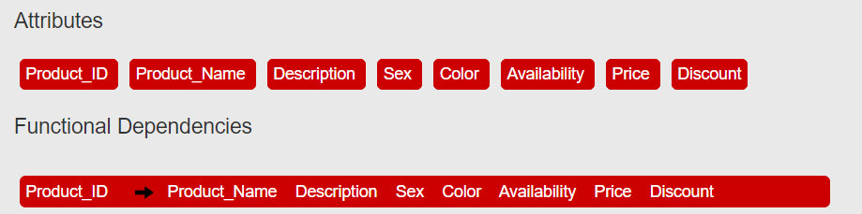
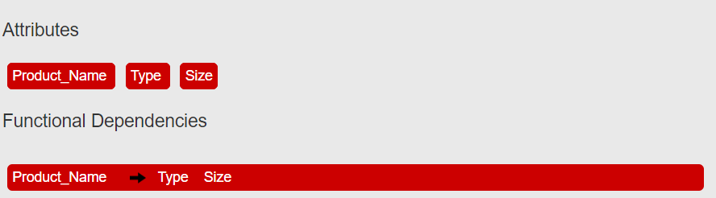
Relational Schema -Normalization
Shoe Details Relation
Shoe_Details
Product_Details

Slide 30
Relational Schema -Normalization
Orders Relation
First, find the minimal cover of the FDs, which includes the FDs Order_ID --> Address_ID Order_ID --> Ordered_Date Order_ID --> Estimated_Delivery_Date Order_ID --> Total_Price Order_ID --> Shipping_Price Order_ID --> Order_Status Order_ID,Product_ID --> Quantity Order_ID,Product_ID --> Price
The relation is not in 2NF

Slide 31
Relational Schema -Normalization
Orders Relation
Initially Orders is the original table:
Round1: checking table Orders The table is not in 2NF. The FD [Order_ID --> Address_ID] is a partial dependency (i.e., LHS is a proper subset of some CK), the table is split into: Orders = (Order_ID,Address_ID,Ordered_Date,Estimated_Delivery_Date,Total_Price,Shipping_Price,Order_Status), with FDs: Order_ID --> Address_ID,Ordered_Date,Estimated_Delivery_Date,Total_Price,Shipping_Price,Order_Status Purchases = (Order_ID,Product_ID,Quantity,Price), with FDs: Order_ID,Product_ID --> Quantity,Price Round2: checking table Orders ***** The table is in 2NF already, send it to output *****
Round3: checking table Purchases ***** The table is in 2NF already, send it to output *****

Slide 32
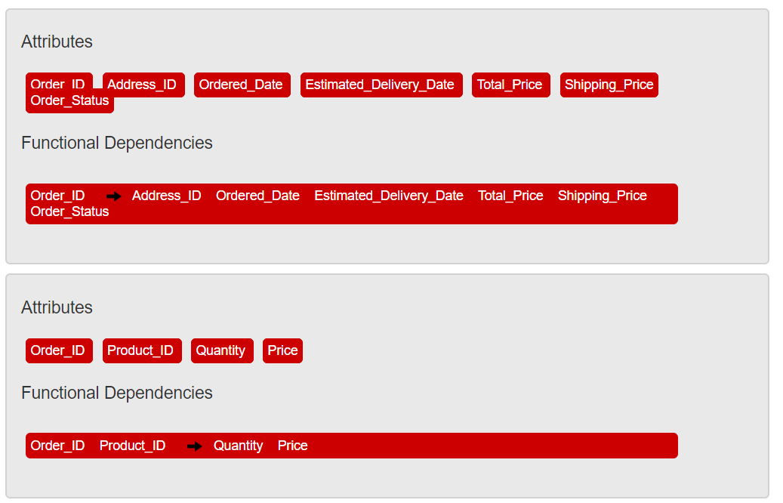
Relational Schema -Normalization
Orders Relation
Orders
Purchases

Slide 33
Relational Schema -Normalization
Orders Relation
Orders
Purchases
Both relations are already in 3NF

Slide 34
Relational Schema -Normalization
Order_History Relation
First, find the minimal cover of the FDs, which includes the FDs Order_ID,Product_ID --> Quantity Order_ID,Product_ID --> Price Order_ID,Product_ID --> Feedback Order_ID,Product_ID --> Rating Order_ID --> Address_ID Order_ID --> Ordered_Date Order_ID --> Delivery_Date Order_ID --> Total_Price Order_ID --> Shipping_Price
The relation is not in 2NF

Slide 35
Relational Schema -Normalization
Order_History Relation
Initially Order_History is the original table: Round1: checking table Order_History The table is not in 2NF. The FD [Order_ID --> Address_ID] is a partial dependency (i.e., LHS is a proper subset of some CK), the table is split into: Order_History = (Order_ID,Address_ID,Ordered_Date,Delivery_Date,Total_Price,Shipping_Price), with FDs: Order_ID --> Address_ID,Ordered_Date,Delivery_Date,Total_Price,Shipping_Price Purchased = (Order_ID,Product_ID,Quantity,Price,Feedback,Rating), with FDs: Order_ID,Product_ID --> Quantity,Price,Feedback,Rating Round2: checking table Order_History ***** The table is in 2NF already, send it to output *****
Round3: checking table Order_History ***** The table is in 2NF already, send it to output *****

Slide 36
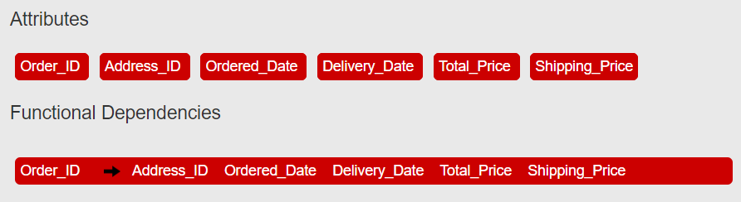
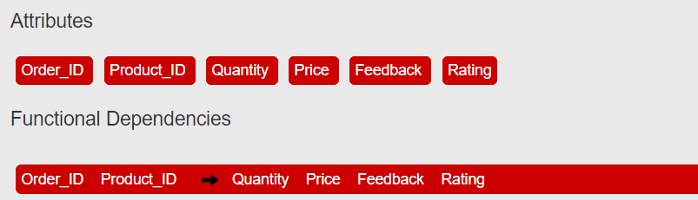
Relational Schema -Normalization
Order_History Relation
Order_History
Purchased
Both relations are already in 3NF

Slide 37
Normalized Relational Schema

Slide 38
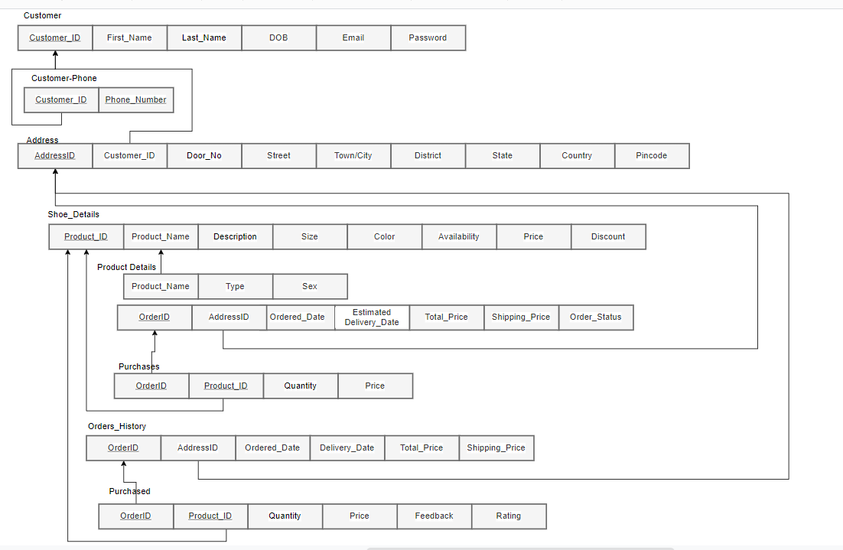
Normalized Relational Schema

Slide 39
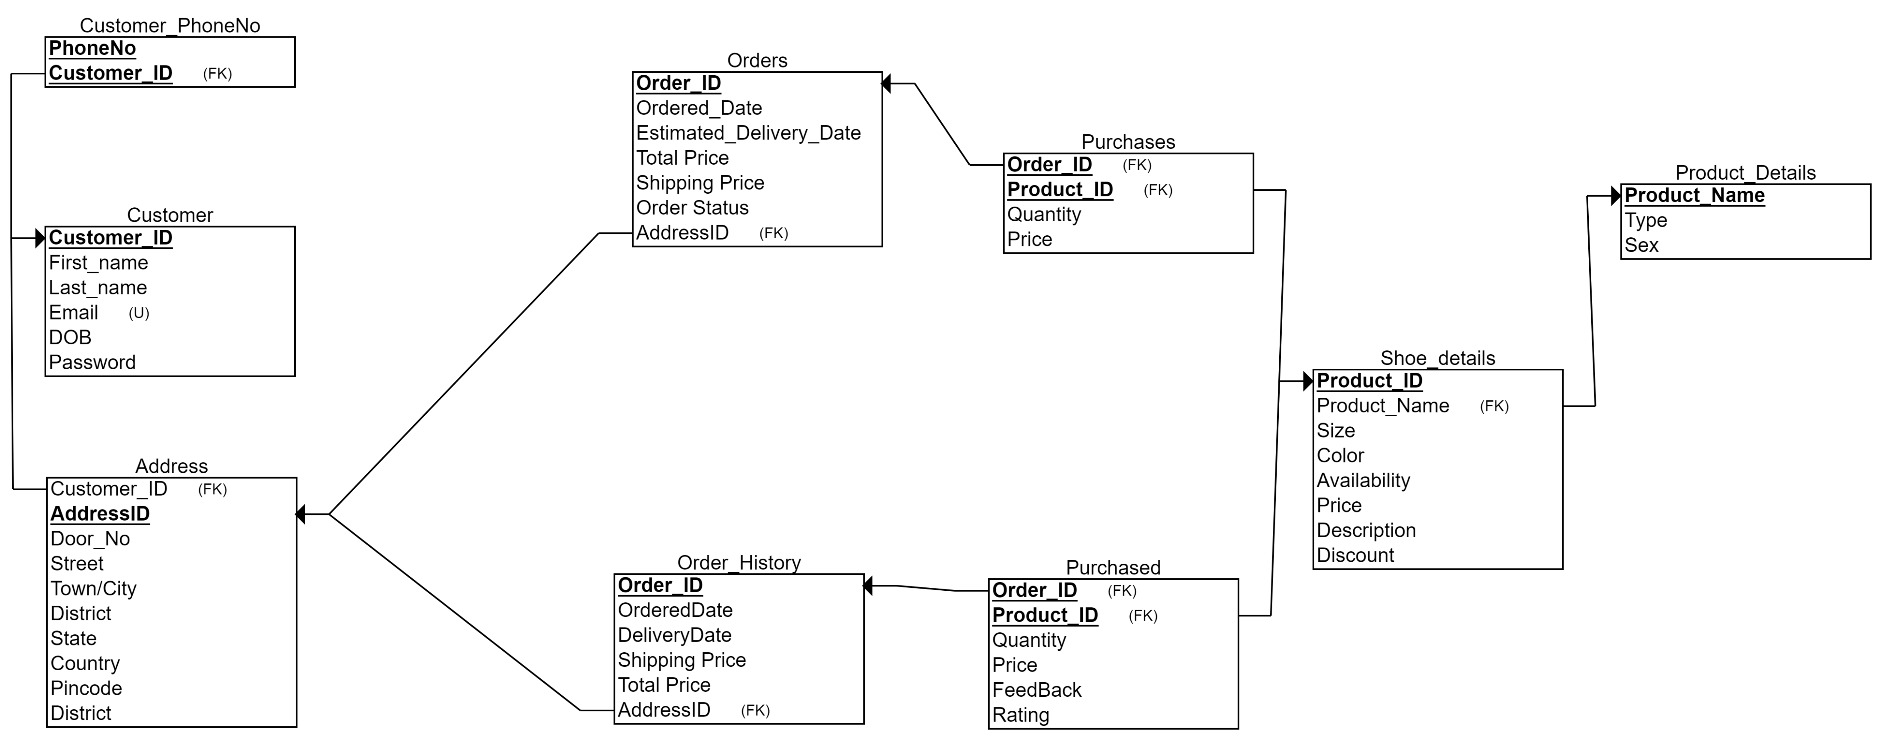
Final Relational Schema

Slide 40




